Slide 1


Slide 2
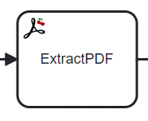
1
2
3
2
3
4
4
5
6
6
7
7
Extract expression: 2-4,6-n

Slide 3

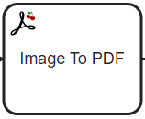




Slide 4
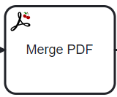
1
2
3
1
2
3
4
5
6
4
5
6
7
7
A
B
&
!
@
A
B
&
!
@

Slide 5
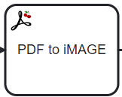
2
2

Slide 6
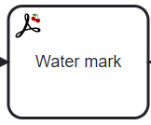
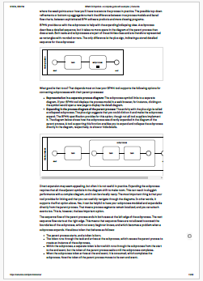
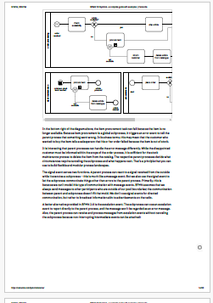
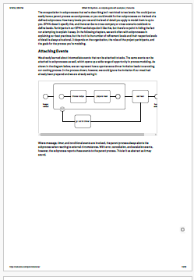
Draft
Draft
Draft

